Slide 1


Data Science Fundamentals
2
+
College of Computer Science And Information Technology
Clustering
2
+
Session 1
Introduction

Slide 2
Clustering
Clustering is the process of finding meaningful groups in data.
For example, customers of a company can be grouped based on the purchase behavior. In recent years, clustering has even found its use in political elections
Clustering to describe the data
Clustering for pre-processing

Slide 3
Types of clustering
Exclusive or strict partitioning clusters
is the hard clustering in which data point exclusively belongs to one cluster.
Overlapping clusters
is a condition of nodes in the network to be a part of another community
Hierarchical clusters
Fuzzy or probabilistic clusters
In fuzzy clustering, data points can potentially belong to multiple clusters.
Based Algorithmic approach
Prototype-based clustering
Density clustering
Hierarchical clustering
Model-based clustering

Slide 4
k-Means Clustering (k-Means)
k-means clustering is a prototype-based clustering method where the data set is divided into k clusters.
K-Means Clustering is an Unsupervised Learning algorithm, which groups the unlabeled dataset into different clusters. Here K defines the number of pre-defined clusters that need to be created in the process, as if K=2, there will be two clusters, and for K=3, there will be three clusters, and so on.
Objective: find a prototype data point for each cluster; all the data points are then assigned to the nearest prototype, which then forms a cluster.

Slide 5

k Partitions
k-means algorithm divides the data space into k partitions or boundaries, where the centroid in each partition is the prototype of the clusters
Voronoi partition. (“Euclidean Voronoi Diagram” by Raincomplex – personal work. Licensed under Creative Commons Zero, Public Domain Dedication via Wikimedia Commons

Slide 6
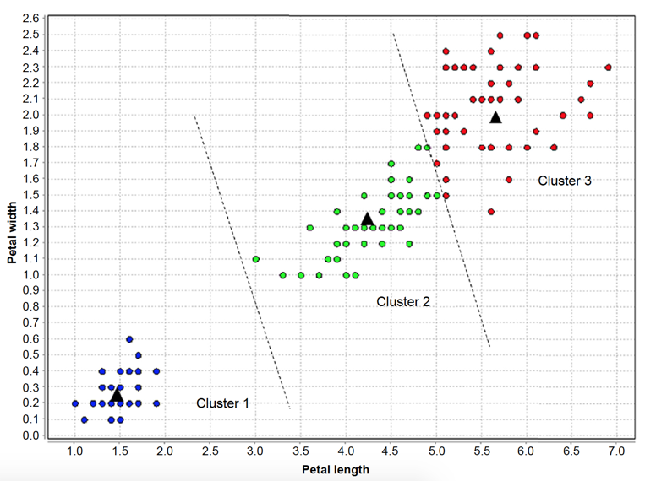
k Partitions
k-means algorithm divides the data space into k partitions or boundaries, where the centroid in each partition is the prototype of the clusters

Slide 7
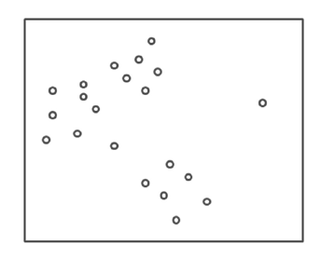
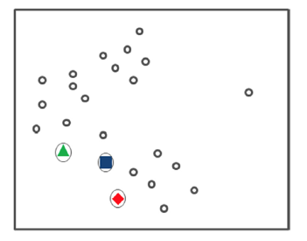
Step 1: Initiate Centroids
What is this

Slide 8
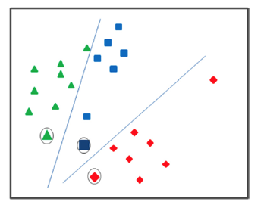

Step 2: Assign Data Points

Slide 9
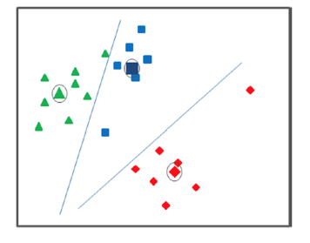

Step 3: Calculate New Centroids
Minimizing the sum of squared errors (SSE)

Slide 10
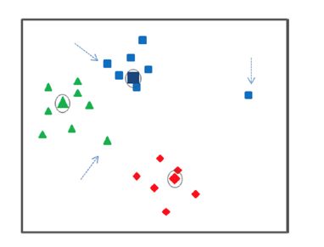
Step 4: Repeat Assignment and Calculate New Centroids
Better to be removed

Slide 11
Step 5: Termination
No further change in assignment of data points happens or, in other words, no significant change in centroids are noted.
Evaluation of Clusters
Minimize total SSE (Sum of Squared Error)
Davies-Bouldin index

Slide 12
K mean clustering steps
Step-1: Select the number K to decide the number of clusters.
Step-2: Select random K points or centroids. (It can be other from the input dataset).
Step-3: Assign each data point to their closest centroid, which will form the predefined K clusters.
Step-4: Calculate the variance and place a new centroid of each cluster.
Step-5: Repeat the third steps, which means reassign each data-point to the new closest centroid of each cluster.
Step-6: If any reassignment occurs, then go to step-4 else go to FINISH.
Step-7: The model is ready.
Notes:
https://www.javatpoint.com/k-means-clustering-algorithm-in-machine-learning

Slide 13
DBSCAN CLUSTERING

Slide 14
DBSCAN CLUSTERING
Centrally, all clustering methods use the same approach i.e. first we calculate similarities and then we use it to cluster the data points into groups or batches.
Why we need DBSCAN since we already have K-Means?
K-Means clustering may cluster loosely related observations together. Every observation becomes a part of some cluster eventually, even if the observations are scattered far away in the vector space.
A slight change in data points might affect the clustering outcome.
This problem is greatly reduced in DBSCAN due to the way clusters are formed.
Another challenge with k-means is that you need to specify the number of clusters (“k”) in order to use it. Much of the time, we won’t know what a reasonable k value is a priori.
There is no need to specify the number of cluster in DBSCAN
All you need is a function to calculate the distance between values and some guidance for what amount of distance is considered “close”.

Slide 15
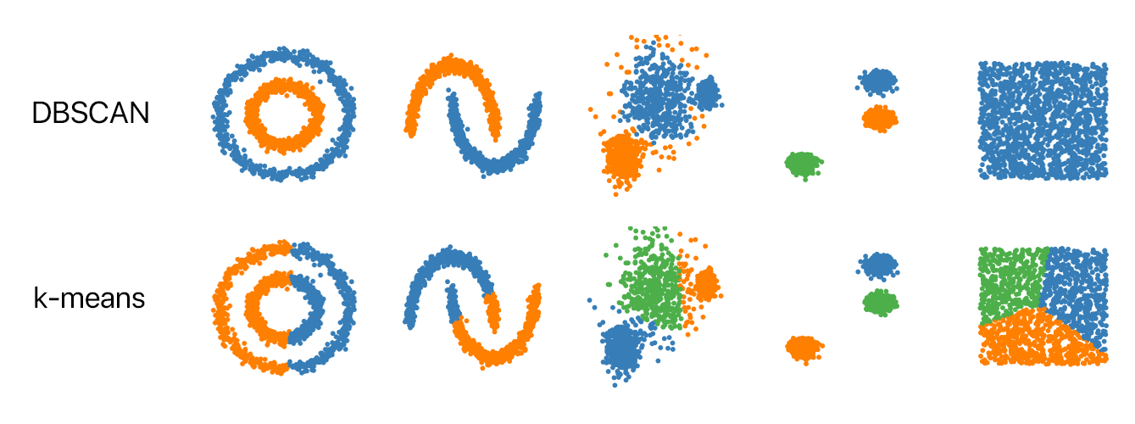
DBSCAN VS K_MEANS

Slide 16
Density-based spatial clustering of applications with noise (DBSCAN)
Is a base algorithm for density-based clustering. It can discover clusters of different shapes and sizes from a large amount of data, which is containing noise and outliers.
The DBSCAN algorithm uses two parameters:
minPts: The minimum number of points (a threshold) clustered together for a region to be considered dense.
eps (ε): A distance measure that will be used to locate the points in the neighborhood of any point.
Notes:
minPts: As a rule of thumb, a minimum minPts can be derived from the number of dimensions D in the data set, as minPts ≥ D + 1. The low value minPts = 1 does not make sense, as then every point on its own will already be a cluster. With minPts ≤ 2, the result will be the same as of hierarchical clustering with the single link metric, with the dendrogram cut at height ε. Therefore, minPts must be chosen at least 3. However, larger values are usually better for data sets with noise and will yield more significant clusters. As a rule of thumb, minPts = 2·dim can be used, but it may be necessary to choose larger values for very large data, for noisy data or for data that contains many duplicates.
ε: The value for ε can then be chosen by using a k-distance graph, plotting the distance to the k = minPts-1 nearest neighbor ordered from the largest to the smallest value. Good values of ε are where this plot shows an “elbow”: if ε is chosen much too small, a large part of the data will not be clustered; whereas for a too high value of ε, clusters will merge and the majority of objects will be in the same cluster. In general, small values of ε are preferable, and as a rule of thumb, only a small fraction of points should be within this distance of each other.
Distance function: The choice of distance function is tightly linked to the choice of ε, and has a major impact on the outcomes. In general, it will be necessary to first identify a reasonable measure of similarity for the data set, before the parameter ε can be chosen. There is no estimation for this parameter, but the distance functions need to be chosen appropriately for the data set.

Slide 17
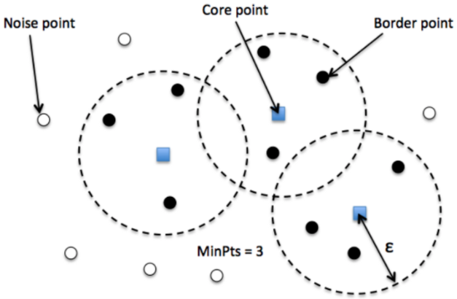
Point types in DBSCAN
Core — This is a point that has at least m points within distance n from itself.
Border — This is a point that has at least one Core point at a distance n.
Noise — This is a point that is neither a Core nor a Border. And it has less than m points within distance n from itself.

Slide 18
DBSCAN algorithm steps
The algorithm proceeds by arbitrarily picking up a point in the dataset (until all points have been visited).
If there are at least ‘minPoint’ points within a radius of ‘ε’ to the point then we consider all these points to be part of the same cluster.
The clusters are then expanded by recursively repeating the neighborhood calculation for each neighboring point

